Slide 1
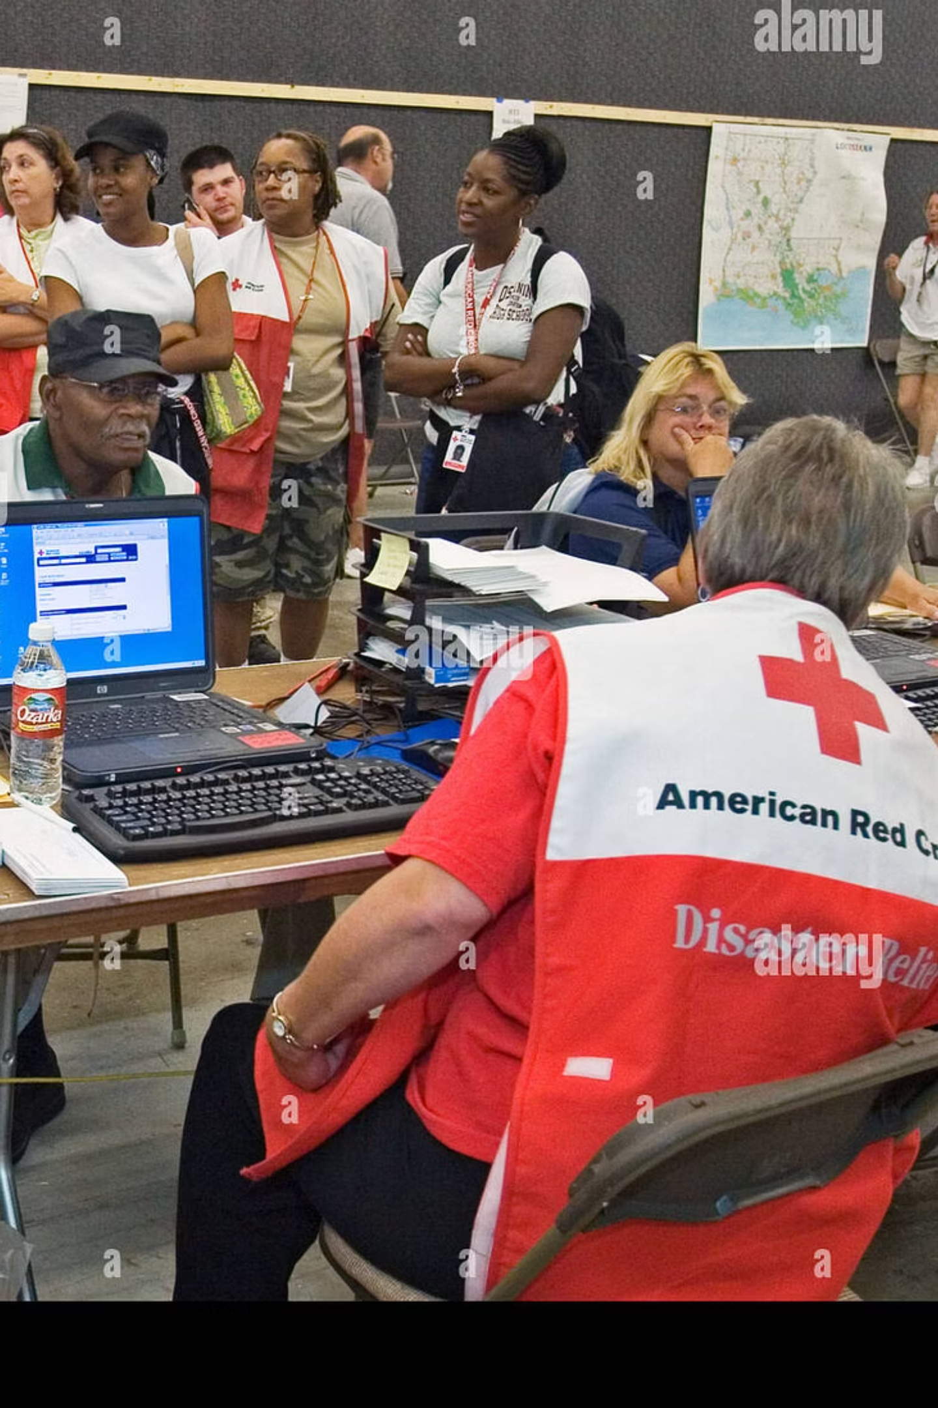
Volunteer Coordination Portal for Disaster Relief
A Technology-Driven Solution for Emergency Management
Hello everyone, I am Ujjwal Tyagi. Today, I am presenting my solution for Case Study 51 — a Volunteer Coordination Portal for Disaster Relief. This system helps track volunteers, assign tasks, and coordinate operations during emergencies.

Slide 2

Problem Statement
During disasters, volunteer management becomes extremely chaotic. Teams often struggle to track who is available, what skills they have, and where they currently are. Schedules become confusing, and task assignment happens manually, which wastes time. There is also no proper channel for real-time communication. All these issues delay relief efforts and reduce their effectiveness.

Slide 3
Proposed Solution
Volunteer Registration
Real-Time Availability
Automated Coordination
Register and update skills
Share current status instantly
Scheduling and task assignment
To solve these problems, I am proposing a centralized Volunteer Coordination Portal. This portal will allow volunteers to register, update their skills, and share real-time availability. It will also support scheduling, shift management, task assignment, location tracking, and emergency notifications. Everything becomes automated and organized.

Slide 4
System Architecture
Frontend Layer
Backend & Integration
Web and mobile app interface
Node.js and Express server
User-friendly dashboard
Google Maps API for location tracking
Real-time updates
SMS and push notifications
This is the high-level architecture of the system. Volunteers and admins access the system through a web or mobile app. The backend is built using Node.js and Express, which handles data flow and business logic. All volunteer details, schedules, and tasks are stored in a secure database like PostgreSQL or MongoDB. The system also integrates with Google Maps API for live location tracking and an SMS or push notification service for emergency alerts.

Slide 5
Key Modules
Volunteer Module
Admin Module
Profile management, skills update, availability marking, task updates
Schedule management, task assignment, live location tracking, reporting
The system has two major modules: First, the Volunteer Module — where volunteers manage their profile, update skills, mark availability, and receive task updates. Second, the Admin Module — where coordinators manage schedules, assign tasks based on volunteer skills, track locations on a live map, and generate reports. These modules work together to enable smooth disaster management.

Slide 6

Technologies Used
Frontend
Backend
React with HTML and CSS for clean, responsive UI
Node.js and Express for fast API handling
Database
Location Services
PostgreSQL or MongoDB for structured data storage
Google Maps API for live tracking and navigation
For the frontend, I am using React along with HTML and CSS to create a clean, responsive UI. The backend uses Node.js and Express for fast API handling. A database like PostgreSQL or MongoDB stores all structured information. Google Maps API enables location tracking, and JWT authentication ensures secure login for both volunteers and admins.

Slide 7
How My Technical Knowledge Helps
1
DBMS Concepts
2
Web Development Skills
Design scalable and secure data storage for volunteer information and operations
Create user-friendly pages for both volunteers and admins with responsive design
3
API Integration
4
Problem-Solving & Logic
Connect maps and notification services for real-time communication
Design efficient scheduling and matching algorithms based on skills and availability
My technical background plays a major role in building this system. Using DBMS concepts, I can design scalable and secure data storage. My web development skills help me create user-friendly pages for both volunteers and admins. API knowledge is used for maps and notification services. Through problem-solving and logic building, I design an efficient scheduling and matching algorithm based on skills and availability. Overall, my full-stack development knowledge helps me convert this societal need into a functional technical solution.

Slide 8
Benefits & Impact
Faster Response
Efficient Utilization
Volunteers located and assigned instantly
No overlap or confusion in task assignment
Real-Time Communication
Transparency
Reduces chaos and improves coordination
Comprehensive reporting system for accountability
This portal greatly improves disaster relief operations. It reduces response time because volunteers can be located and assigned instantly. It ensures that volunteers are used efficiently, and there is no overlap or confusion. Real-time communication reduces chaos, while the reporting system improves transparency. Ultimately, it makes relief operations much more organized and effective.
Conclusion
To conclude, a technology-driven approach like this Volunteer Coordination Portal can make a massive difference during disaster situations. It helps save time, improves coordination, and indirectly saves lives. Thank you for listening.

